Slide 1

WELCOME
COHORT 5
7th Sept – 3rd Dec 2026
Suite 6-6-7, Level 6, Menara MAA

Slide 2
Contents
Introduction to Pydantic
Introduction to Router
Introduction to Dependencies & Auth

Slide 3
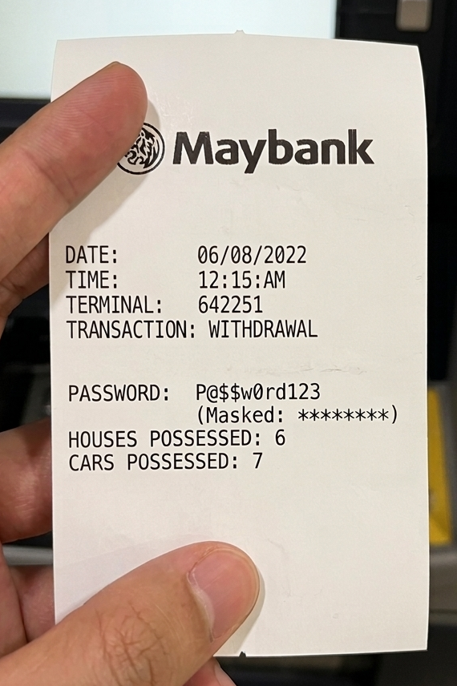
Pydantic
library for data validation & data parsing
Use:
  Control API output
  Protect sensitive data
Example:
  Faulty ATM → Print Receipt
  How to Fix? Create a Response Model

Slide 4
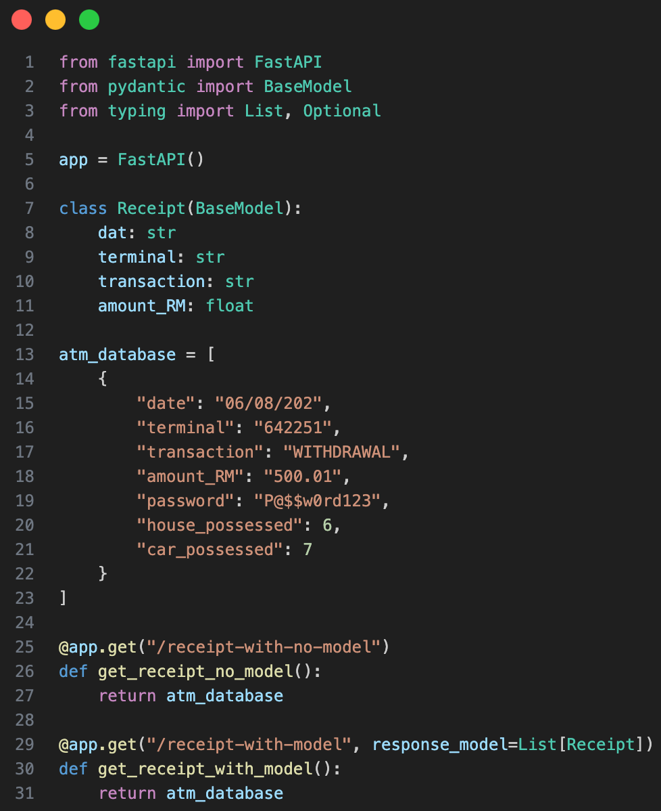
How to create Response Models
FastAPI is a machine.
To use the machine, you must turn it on
def to do work
class to defines structure
[ ] - list contains items, each item is a dict , stores multiple items
{ } - dict , Key : Value , stores structured data
Notes:
we declare receipt as class that uses basemodel

Slide 5
Router
Organize code – Separate endpoints into different files
Team collaboration – Different developers can work on different features
Easier debugging – Smaller files are easier to maintain and fix
Backend/
├─| 2.routers/
│ ├── __init__.py <- empty file
│ ├── left_window.py
│ ├── right_window.py
__init__.py file turns a regular folder into a special, importable Python package. For many cases, it can be completely empty; its presence is all that matters.
Notes:
from . import left_window, right_window
__all__ = ["LeftWindowAction", "RightWindowAction"]

Slide 6
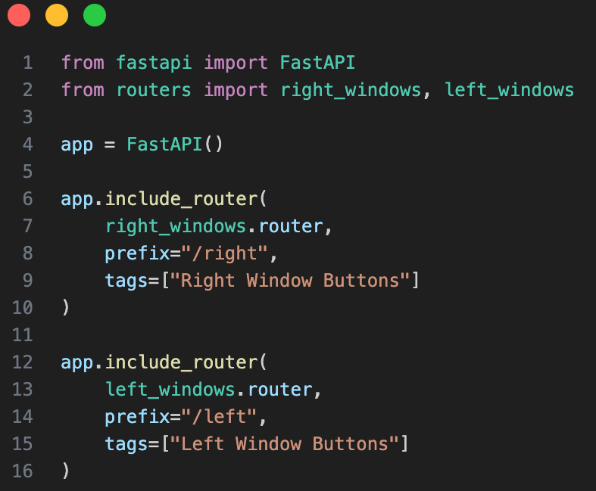
Router - main (main.py)

Slide 7
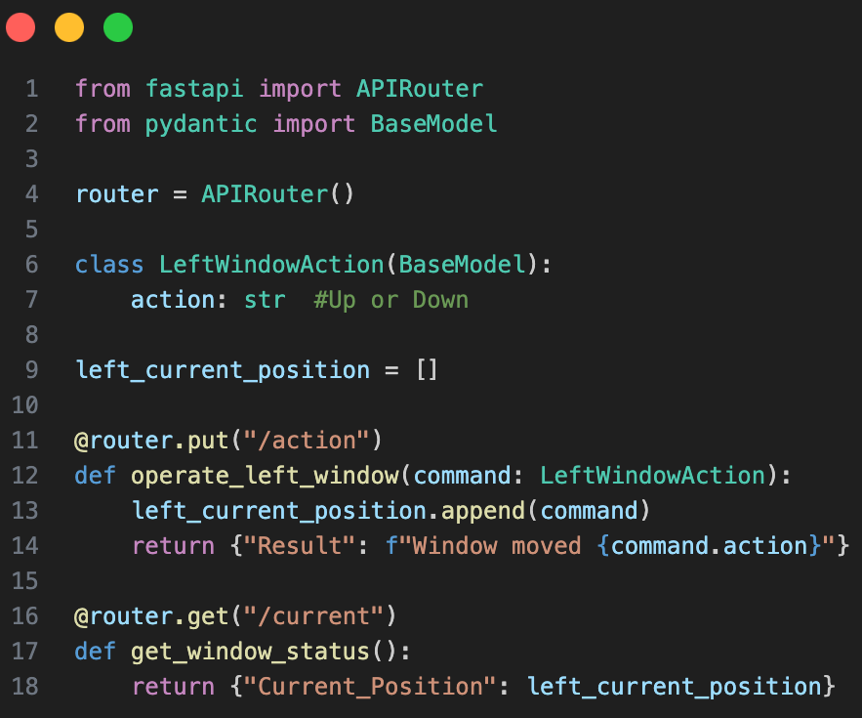
Router - sub (left_window.py)
Exercise:
Do the same for the right_window.py
#hint: change any “left” to “right”

Slide 8
Middleware
Hidden script that runs automatically
Use:
Logging
Authentication
Safety
Example:
Car’s fuel sensor
  Watch fuel level before drive (Authentication & Safety)
  Watch fuel level during driving
  Watch fuel level after driving and log it’s fuel economy (Logging)

Slide 9
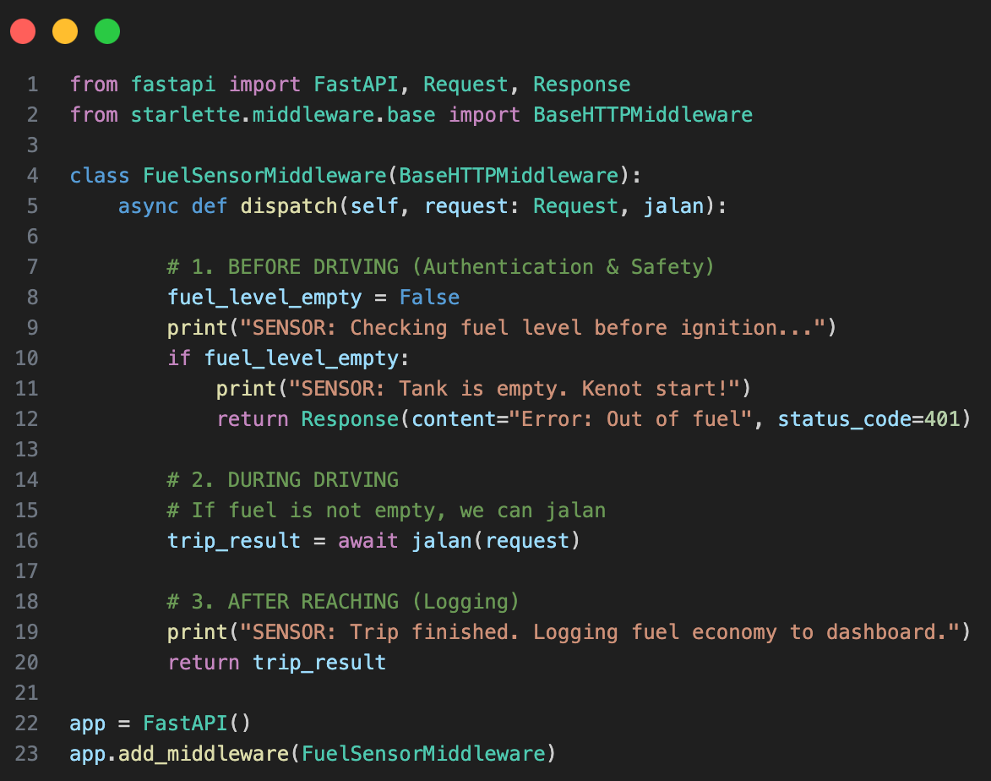
BaseHTTPMiddleware
Notes:
@app.get("/")
def root():
return {"message": "Middleware example. Check your terminal for logs."}

Slide 10
Dependencies
Specialist tools that run only when a specific route asks for them
Function:
Database Sessions
User Validation
Resource Cleanup
Example:
Fuel Pump: In city use eco mode , In highway use sports mode
Database experience high traffic/usage , turn the dependencies on demand
Difference:
Middleware is "Always-On" , Dependency is "On-Demand"

Slide 11
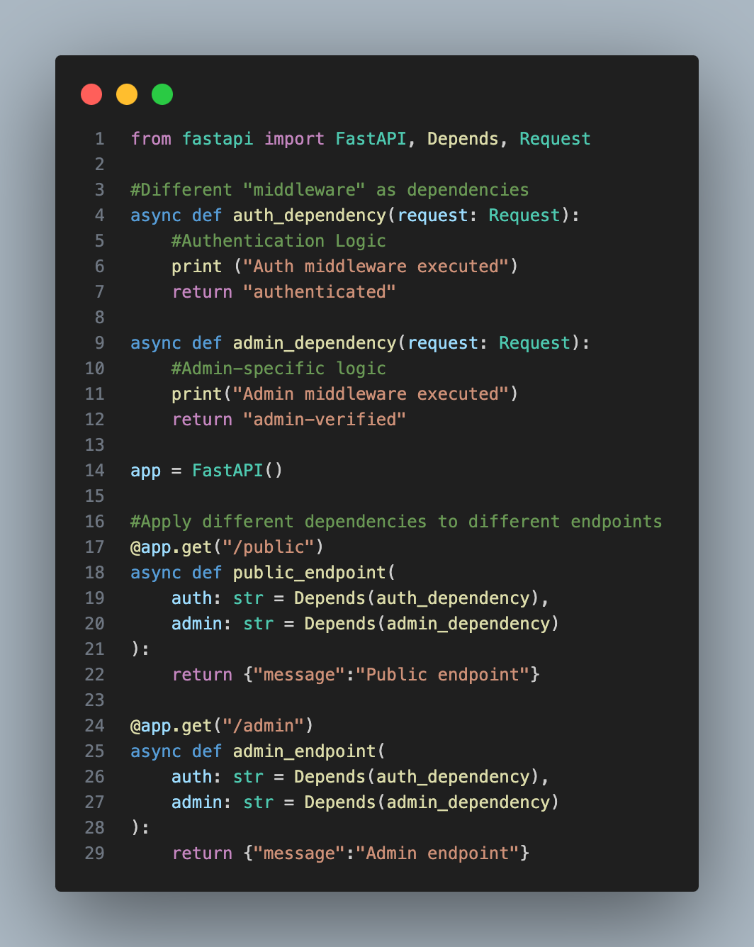
Dependencies

Slide 12
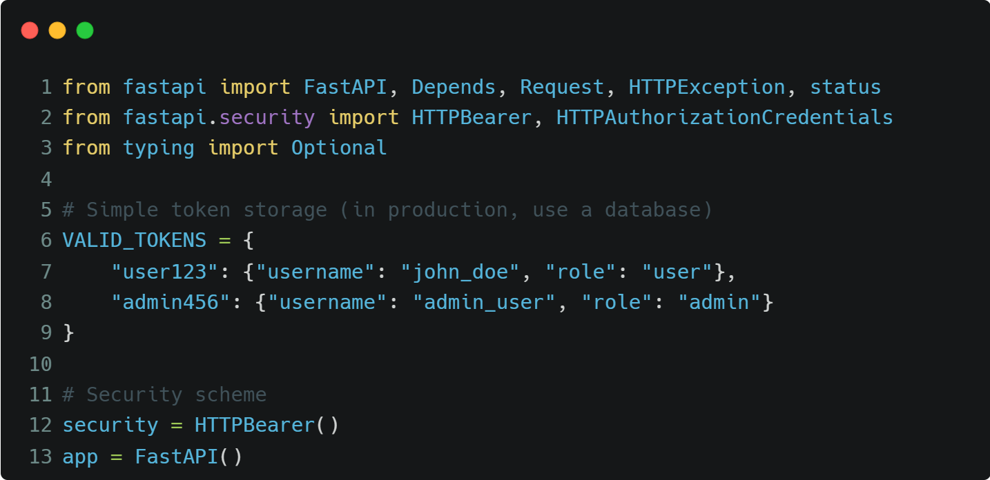
Basic Authentication
Protect specific endpoint with password
Only allow certain endpoint to certain role only

Slide 13
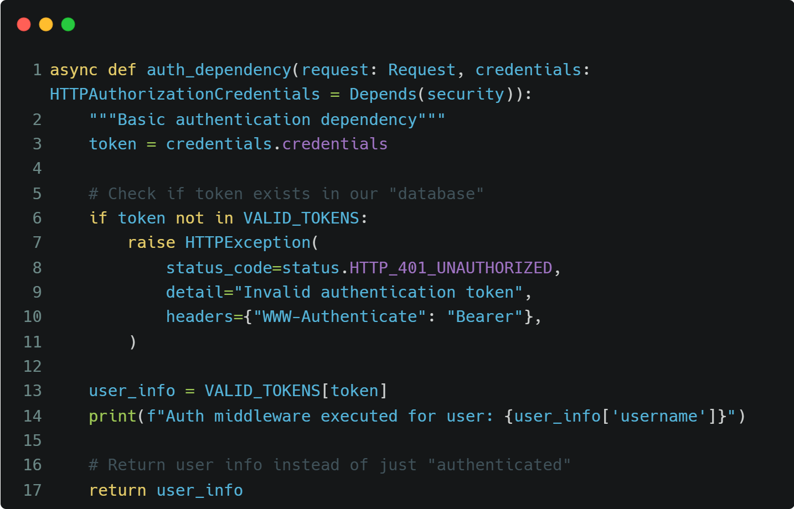
Basic Authentication

Slide 14
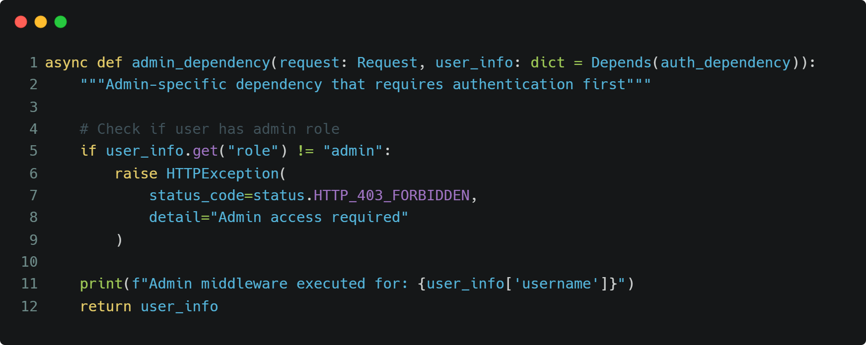
Basic Authentication

Slide 15
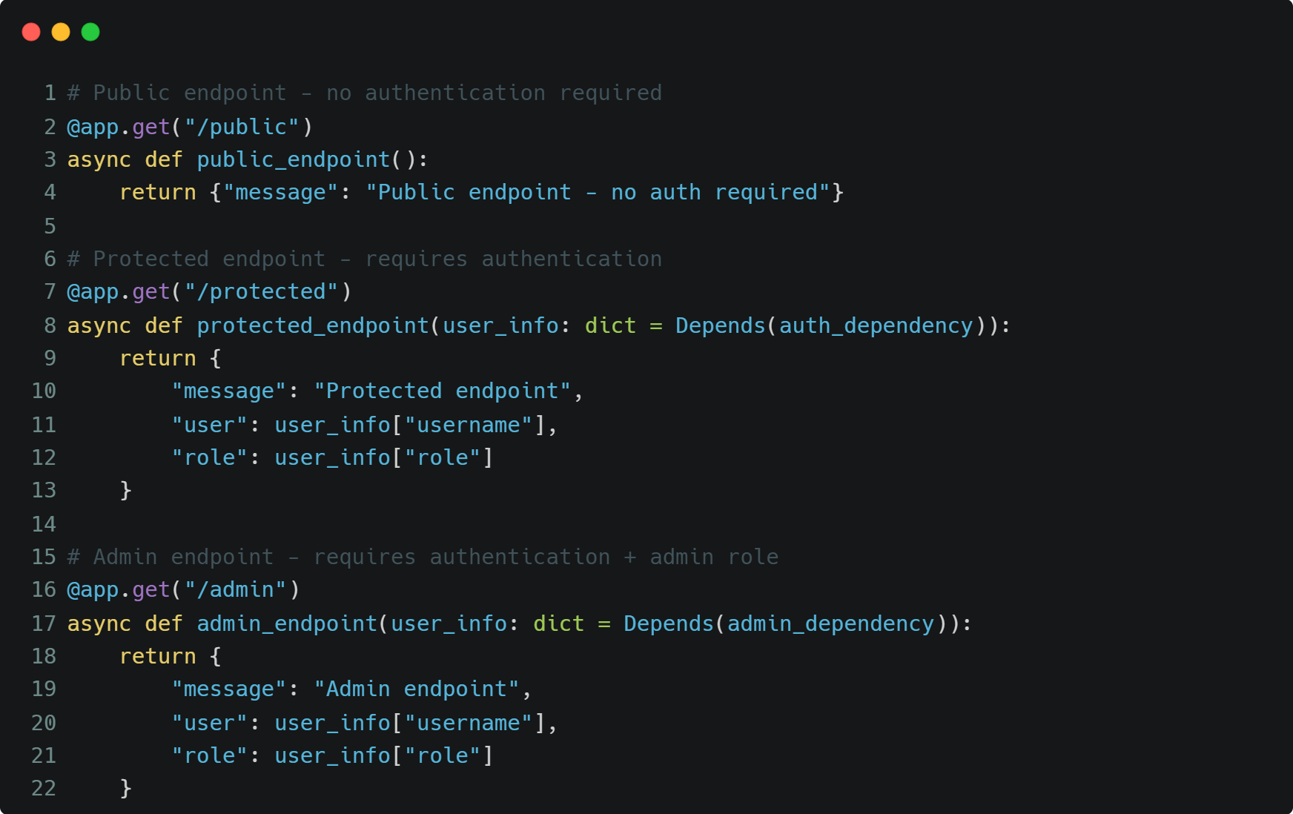
Basic Authentication

Slide 16
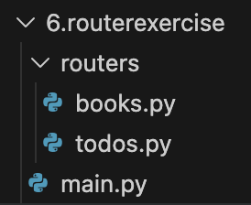
Exercise : Todos & Books API
Implement router using fastapi package to combine books and todos endpoints from previous day slides.
todos endpoints from yesterday’s slide exercise is in presenter notes.
Sample folder structure
Notes:
from fastapi import FastAPI, Body
from datetime import date
app = FastAPI()
TODOS = [
{"id": 1, "task": "Learn Python", "completed": False, "due_date": "2025-11-15"},
{"id": 2, "task": "Practice coding", "completed": False, "due_date": "2025-11-12"},
{"id": 3, "task": "Take a break", "completed": False, "due_date": "2025-11-12"},
{"id": 4, "task": "Build FastAPI project", "completed": False, "due_date": "2025-11-18"}
]
next_id = 5
@app.get('/')
async def read_root():
return {"message": "Welcome to the To-Do List FastAPI!"}
@app.get('/todos')
async def get_all_todos():
return TODOS
@app.get('/todos/filter_by_completed')
async def get_todos_by_completed_query(completed: bool):
completed_todos = []
for todo in TODOS:
if todo.get("completed") == completed:
completed_todos.append(todo)
return completed_todos
@app.get('/todos/filter_by_completed_and_date')
async def get_todos_by_completed_and_date_query(completed: bool, due_date: str):
todos_to_return = []
for todo in TODOS:
if todo.get("completed") == completed and todo.get("due_date").casefold() == due_date.casefold():
todos_to_return.append(todo)
return todos_to_return
@app.get('/todos/{task_name}')
async def get_todo_by_task(task_name: str):
for todo in TODOS:
if todo.get("task").casefold() == task_name.casefold():
return todo
return "Task not found"
@app.post('/todos/create_task')
async def add_task(new_task_body=Body()):
global next_id
task_name = new_task_body.get("task")
due_date_str = new_task_body.get("due_date")
if not task_name:
return "Task name is required."
if not due_date_str:
due_date_str = date.today().isoformat()
new_task = {
"id": next_id,
"task": task_name,
"completed": False,
"due_date": due_date_str
}
TODOS.append(new_task)
next_id += 1
return "Task created successfully!"
@app.put('/todos/update_task')
async def update_task(updated_task_body=Body()):
for i in range(len(TODOS)):
if TODOS[i].get("task").casefold() == updated_task_body.get("task").casefold():
TODOS[i] = updated_task_body
return "Task updated successfully!"
return "Task not found"
@app.delete('/todos/delete_task/{task_name}')
async def delete_task(task_name: str):
for i, todo in enumerate(TODOS):
if todo.get("task").casefold() == task_name.casefold():
TODOS.pop(i)
return "Task deleted successfully!"
return "Task not found"

